Slide 1

Name of the project
Sudoku game
Welcome to my project presentation
Submitted to, Submitted by,
Md.Mahfuz Reza Md.Riazul Islam
Assistant professor, ID: CE-14047 Sesson: 2013-14 Dept. of CSE, MBSTU Year: 2nd Semester: 1st

Slide 2
Purpose of the game
Playing this game anyone can pass his leisure period
Also one can increase his General Technique.

Slide 3

Sudoku Game in C – Project Introduction
This is a complete and error-free Sudoku Game Project in C designed as a simple console application.
In sudoku game,the game has simple rules. The game presented in this article arranges numbers in 9X9 matrix,which is th most common form of this game.The rules are as follows:

Slide 4
This game divided into four difficlty level; user choice any difficulty level.
Very easy ,easy, medium,hard four level game.
First excutive the program then 1 type ganerate sudoku game.
If the user is not capable of doing that, he is not permitted to proceed further.

Slide 5
This program uses c programming language. Graphics and others functions.
When we play this game three option has.1.solve the sudoku game by youself. when y keyword press.2. solution sudoku game when s keyword press.3.other sudoku game ganerate when m keyword press.this system following is given bellow.

Slide 6
Applying mehtods
I have divided this mini project into many functions, and listed below are some of those which may help you understand the project better.
help() – help menu with game summary and rules
Solve()- solution the sudoku game.
Checkmat()-this function use check the matrices.
Checkrow()- this function use check the row.
Checkcolumn()-this function use the column.
Check()- this function use check the game.
Display()- this function use display the game.

Slide 7
I have used rand() function to get the puzzles randomly.
.
The source code is to be compiled in Code::Blocks with gcc compiler.

Slide 8

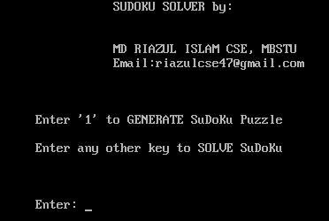
Steps of the game
First step:
When a player run the
Program will like this
From this he has to choose a
option and press corresponding key.

Slide 9
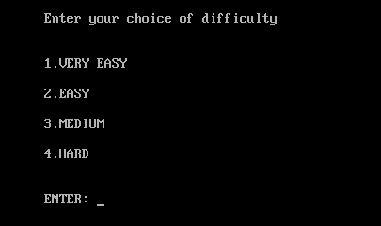
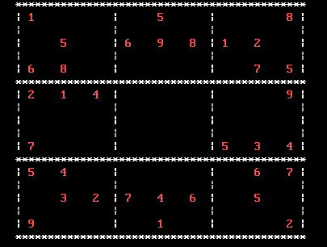
Second step:
This step shows difficulty level.

Slide 10

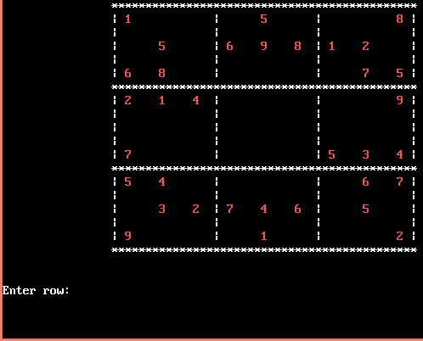
This step shows the item.

Slide 11
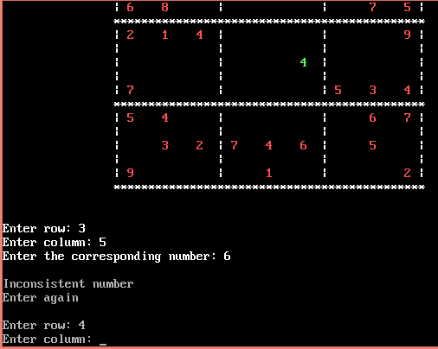
Third step:
This step shows solve sudoku by yourself.

Slide 12
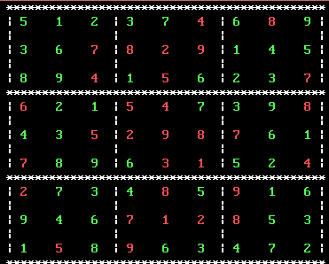
Fourth step:
This steps shows solve sudoku.

Slide 13


For seeing this
Let’s play and justify your knowledge !!!

